Slide 1
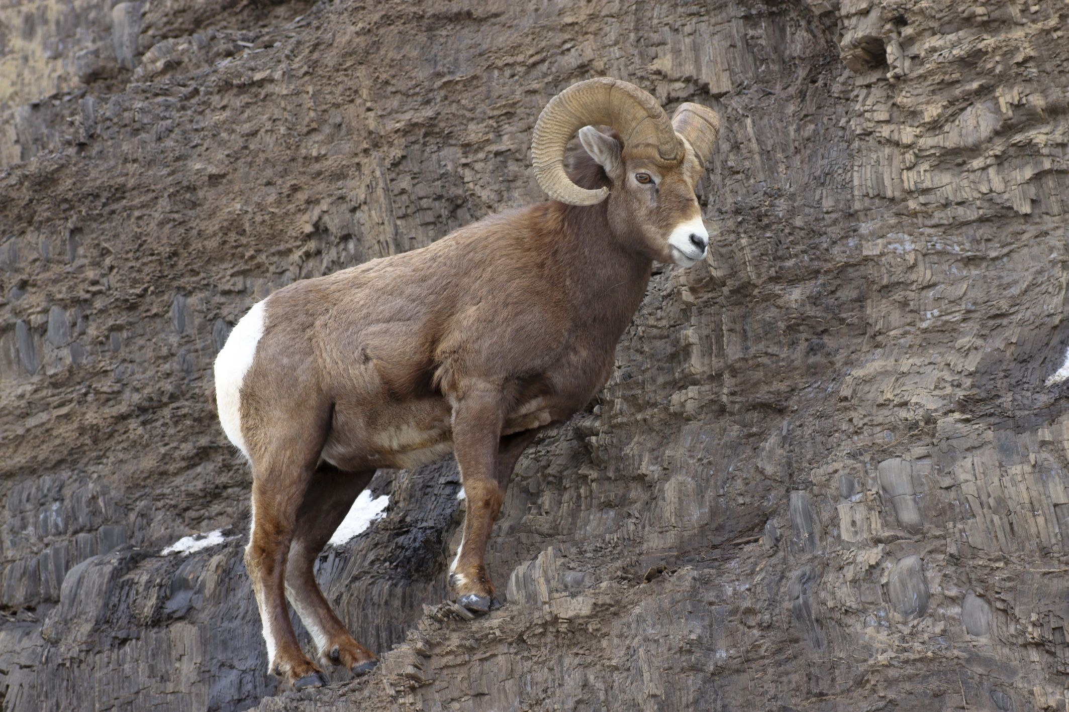


Bighorn Sheep: On the Edge?
Copyright: The Wild Sheep Foundation and Bear Trust International 2013

Slide 2
Bighorn Sheep: On the Edge?
Are bighorn sheep on the edge?
As part of this activity, you will be working in groups to
answer this question
To answer questions about what’s happening today, it often helps to begin by looking at the past…..

Slide 3
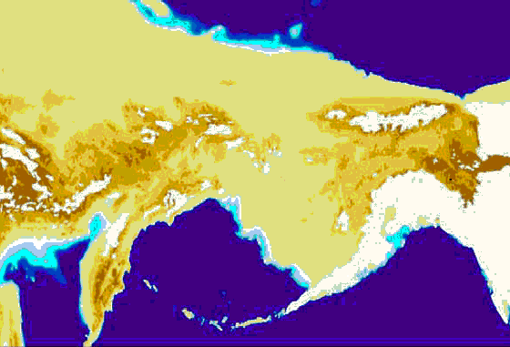
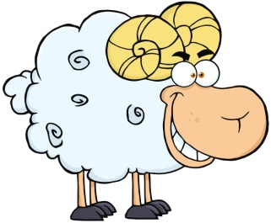
The Past
Wild sheep in North America are descended from Asian snow sheep
which crossed over the Bering Land Bridge about 750,000 years ago
Siberia
Alaska
Bering Land Bridge
Bering Land Bridge Image by Creative Commons

Slide 4
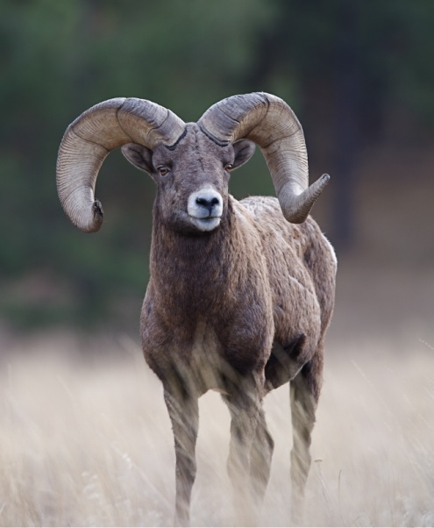
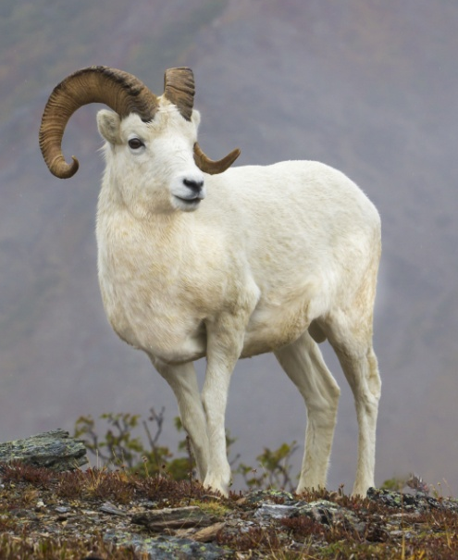
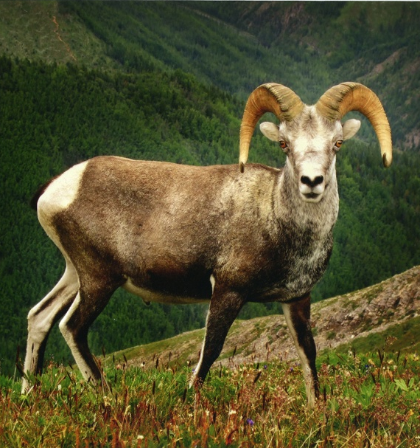
The Past
Wild sheep in North America are descended from Asian snow sheep
which crossed over the Bering Land Bridge about 750,000 years ago
Today, 2 species of wild sheep occur in North America
Bighorn Sheep
Thinhorn Sheep
Dall’s Sheep
Stone’s Sheep
Stone’s Sheep
Photo by David Reed
For this lesson, we’ll focus on bighorn sheep
How many wild bighorn sheep were in the US before European settlement?
Let’s fast forward a few hundred thousand years.

Slide 5
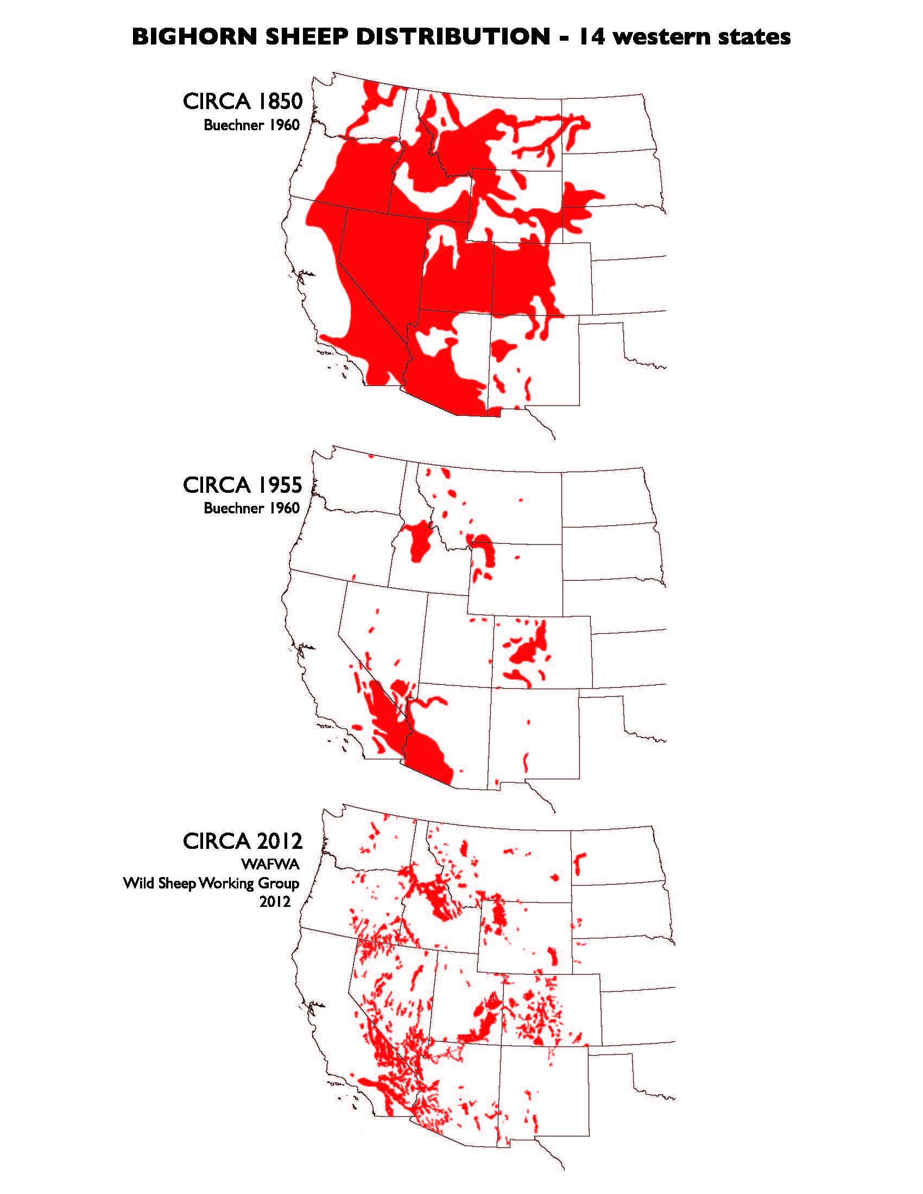
Counting Sheep: How Many?
In the 1800s, there were about 2 million bighorn sheep
1800s
and their historic range included most of the west
2 Million
1800s
Year
Map: Buechner 1960

Slide 6
Counting Sheep: How Many?
By the early 1900s, the number of bighorn sheep declined to about 15,000
1800s
2 Million
And their range was
much reduced
What happened?
1900s
European settlement
Unregulated hunting
Habitat loss
Predation
Disease transfer to wild bighorns from domestic livestock
Competition for food with domestic livestock
15,000
1800s
1900s
Year
Map: Buechner 1960

Slide 7
Counting Sheep: How Many?
Today, there are about 70,000 bighorn sheep
1800s
2 Million
1900s
And their range has
increased since the 1900s
70,000
Today
15,000
1800s
1900s
2013
Year
Map: Wild Sheep Working Group 2012

Slide 8
Counting Sheep: How Many?
Today, there are about 70,000 bighorn sheep
1800s
2 Million
Let’s find out!
1900s
How did the number of bighorn
sheep and their range increase?
70,000
Today
15,000
1800s
1900s
2013
Year
Map: Wild Sheep Working Group 2012

Slide 9
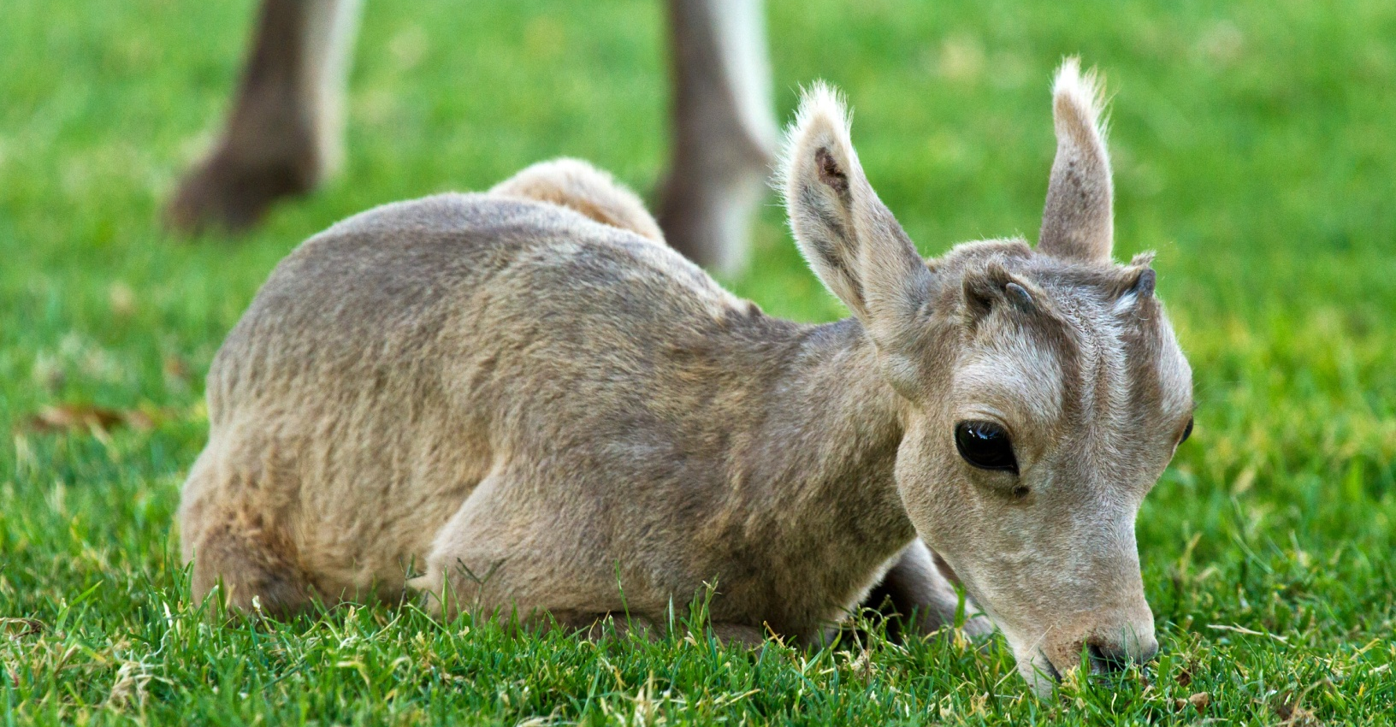
How the Number and Range of Bighorns Increased
After the dramatic decline of wild bighorns in the early 1900s, state
wildlife agencies and hunting organizations worked together to find
ways to bring wild bighorn sheep back into parts of their historic range
Part of this conservation effort included a TRANSPLANT program

Slide 10
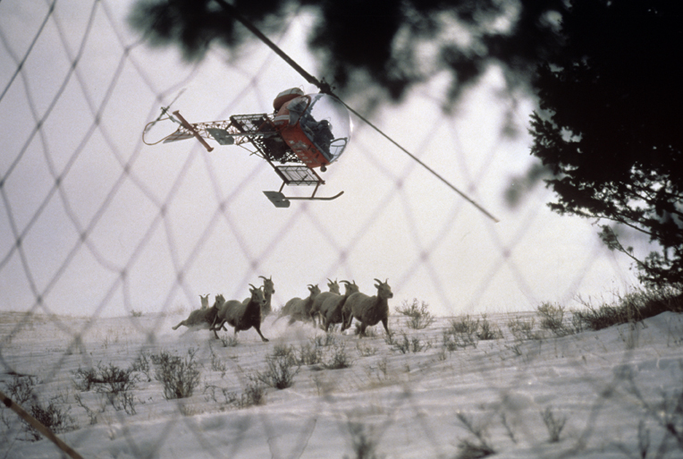
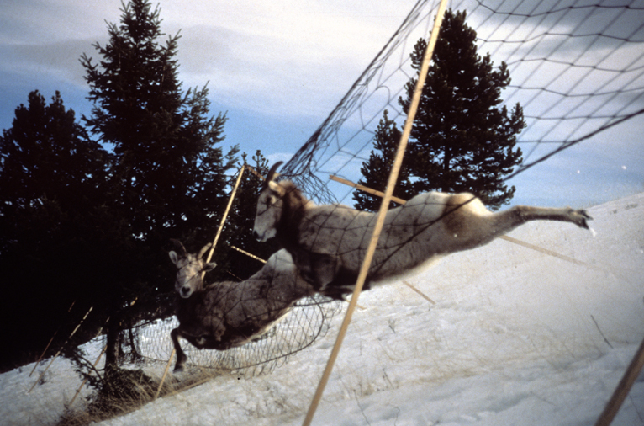
How the Number and Range of Bighorns Increased
Trap individuals in one location
When you trap individuals from a healthy population in one location
and move (transplant) them to another location
What’s a TRANSPLANT program?
Part of this conservation effort included a TRANSPLANT program

Slide 11
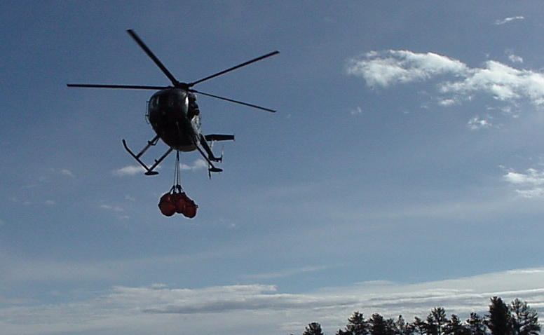
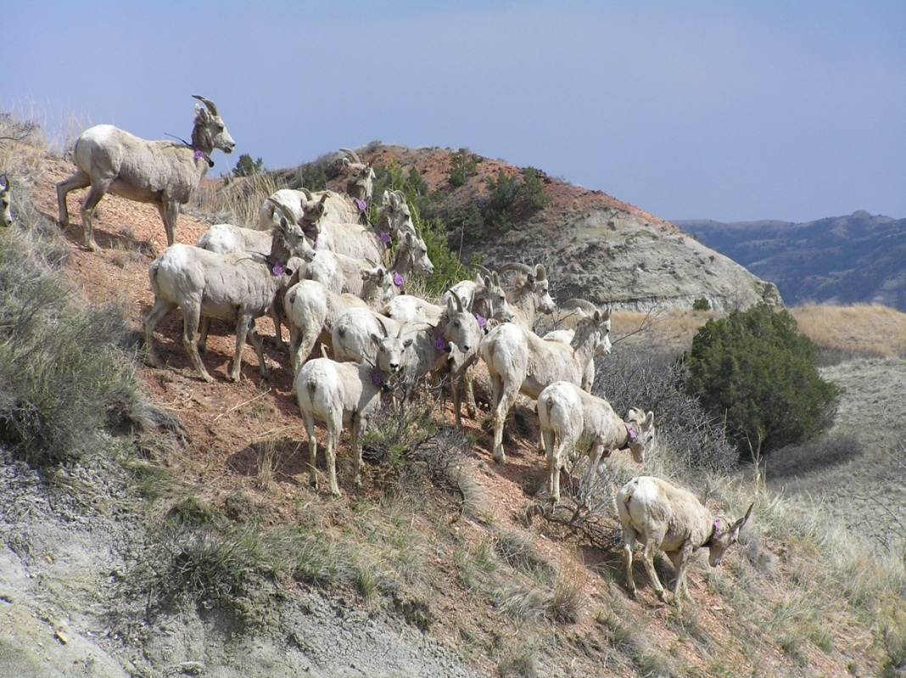
How the Number and Range of Bighorns Increased
Trap individuals in one location
and move them
to another location
Photos on this slide: MT FWP

Slide 12
How the Number and Range of Bighorns Increased
Around year 1960, many western states began transplant programs to help increase small, remnant bighorn sheep populations and to reintroduce bighorn sheep into historic, but vacant, habitat
And it was a success!

Slide 13
How the Number and Range of Bighorns Increased
Around year 1960, many western states began transplant programs to help increase small, remnant bighorn sheep populations and to reintroduce bighorn sheep into historic, but vacant, habitat
And it was a success!
…….first, let’s learn a bit more about bighorn sheep
2 Million
Bighorn sheep numbers increased in many areas in the west because of these transplant efforts
To answer this question, you will be using REAL DATA and
case studies about wild bighorn sheep herds………..
But that’s not the whole story
70,000
What factors are affecting the conservation of bighorn sheep?
Although the number of bighorns have increased since the 1900s, many herds have experienced, and continue to experience, die-offs
15,000
Why?
1800s
1900s
2013

Slide 14
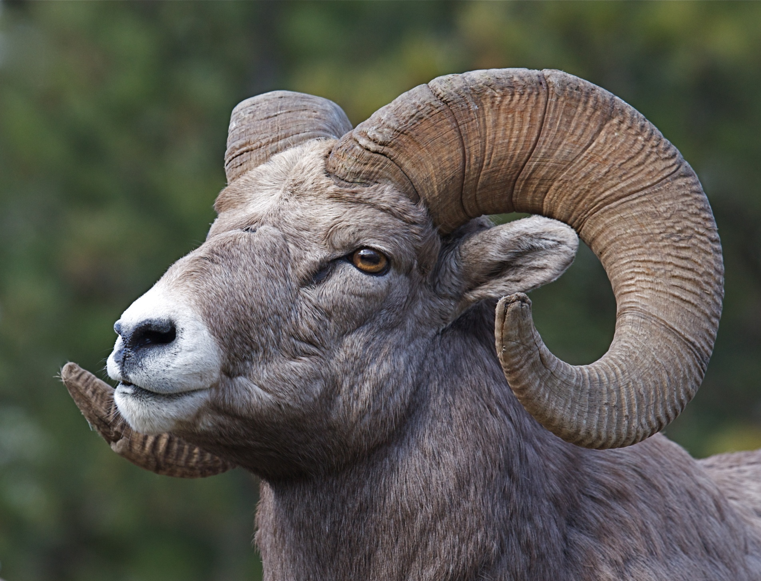
More About Bighorn Sheep
They are named bighorn sheep because…..
Male sheep are called RAMS, and their horns can weigh up to 30 pounds and be over 3 feet long!
The lifespan of wild rams is typically between 9-12 years
Rams can weigh over 350 pounds!

Slide 15
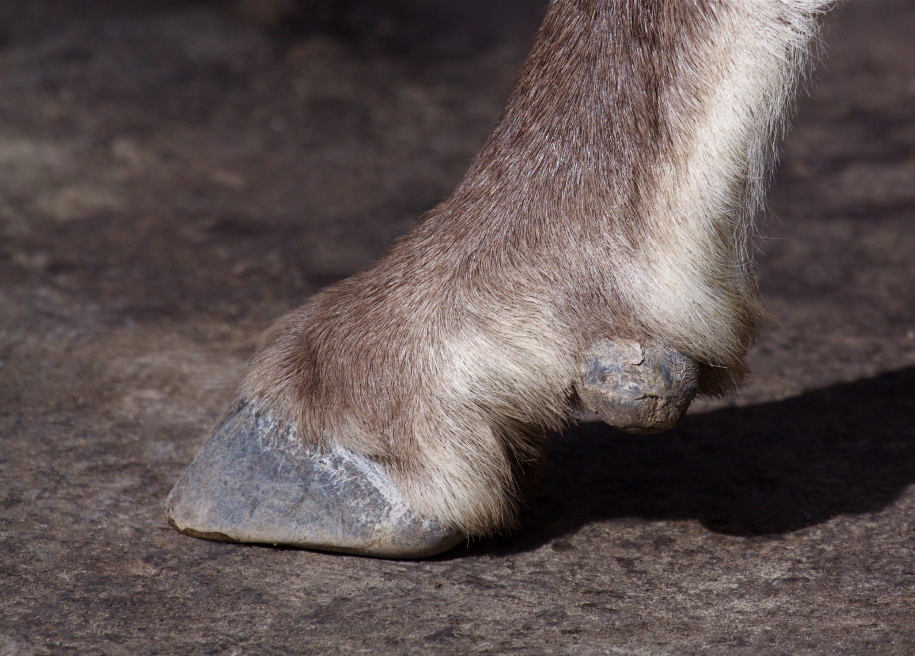
More About Bighorn Sheep
Bighorn sheep are well-equipped for climbing steep terrain
Their outer hooves are modified toenails with a soft inner pad that provides grip
The ledges they climb on are sometimes only 2 inches wide!

Slide 16
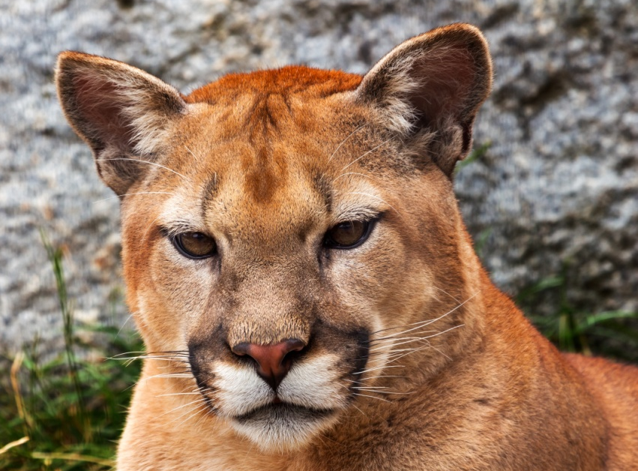
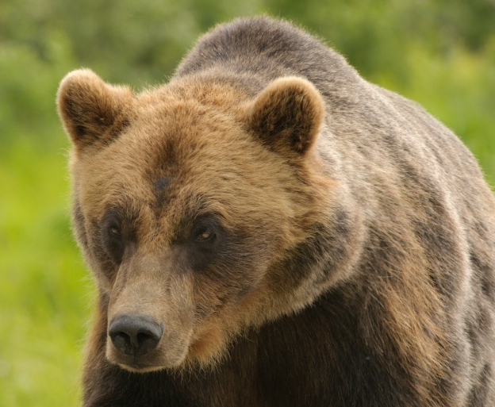
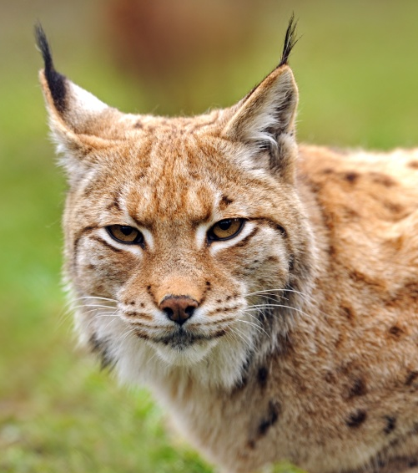
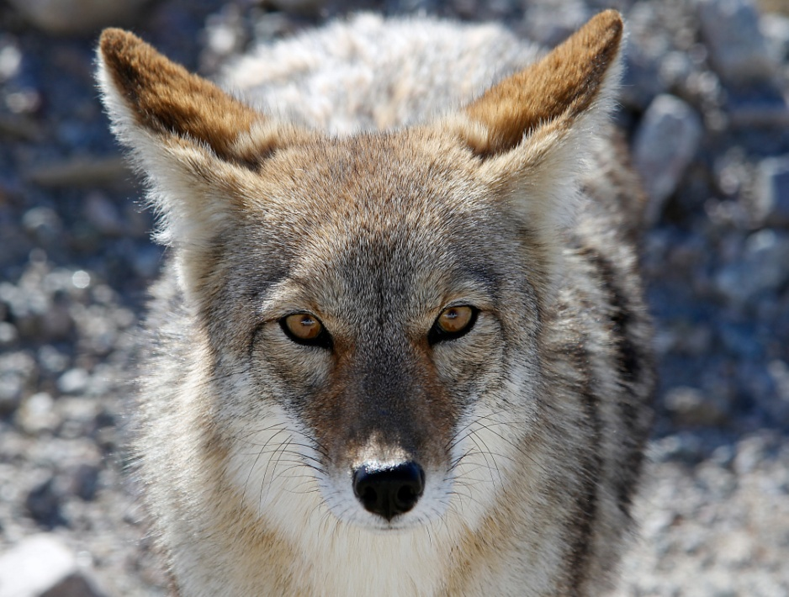
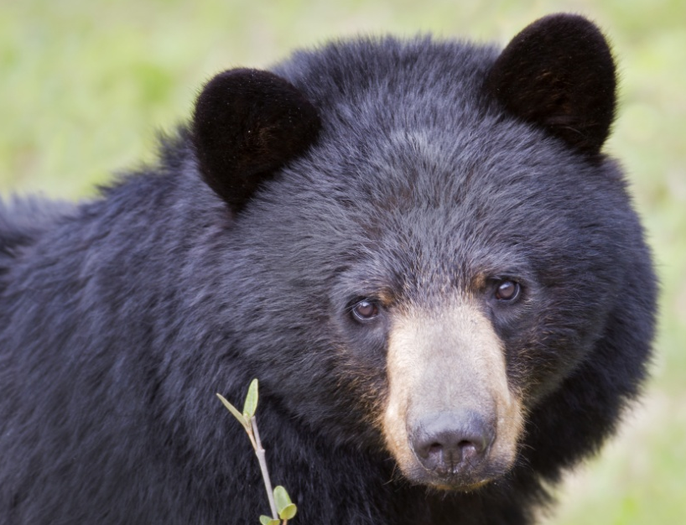
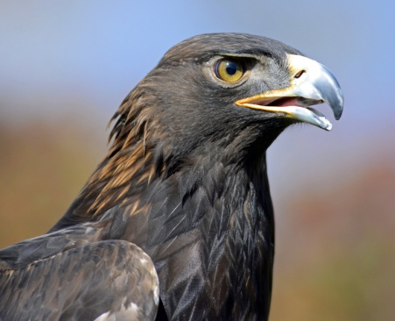
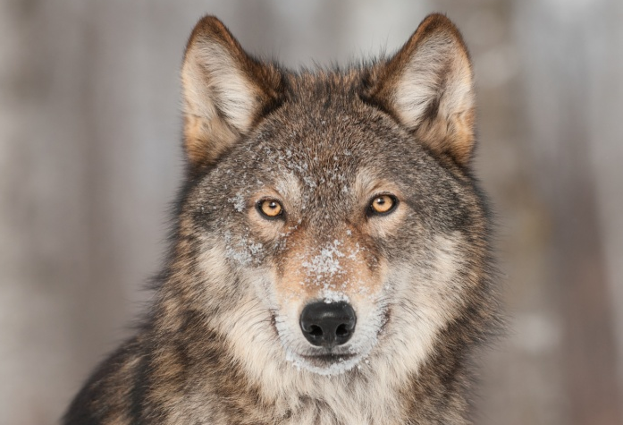
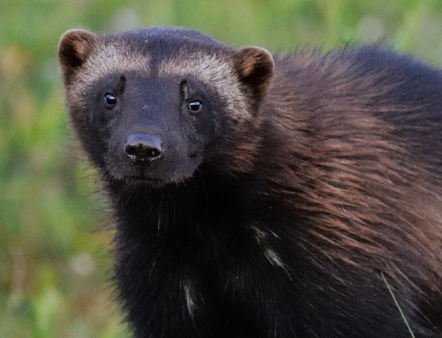
More About Bighorn Sheep
The steep terrain that bighorn sheep climb on helps them avoid PREDATORS like………
Mountain Lions
Brown Bears
Lynx
Coyotes
Black Bears
Golden eagles are also predators but steep terrain doesn’t stop them
Wolves
Wolverines

Slide 17
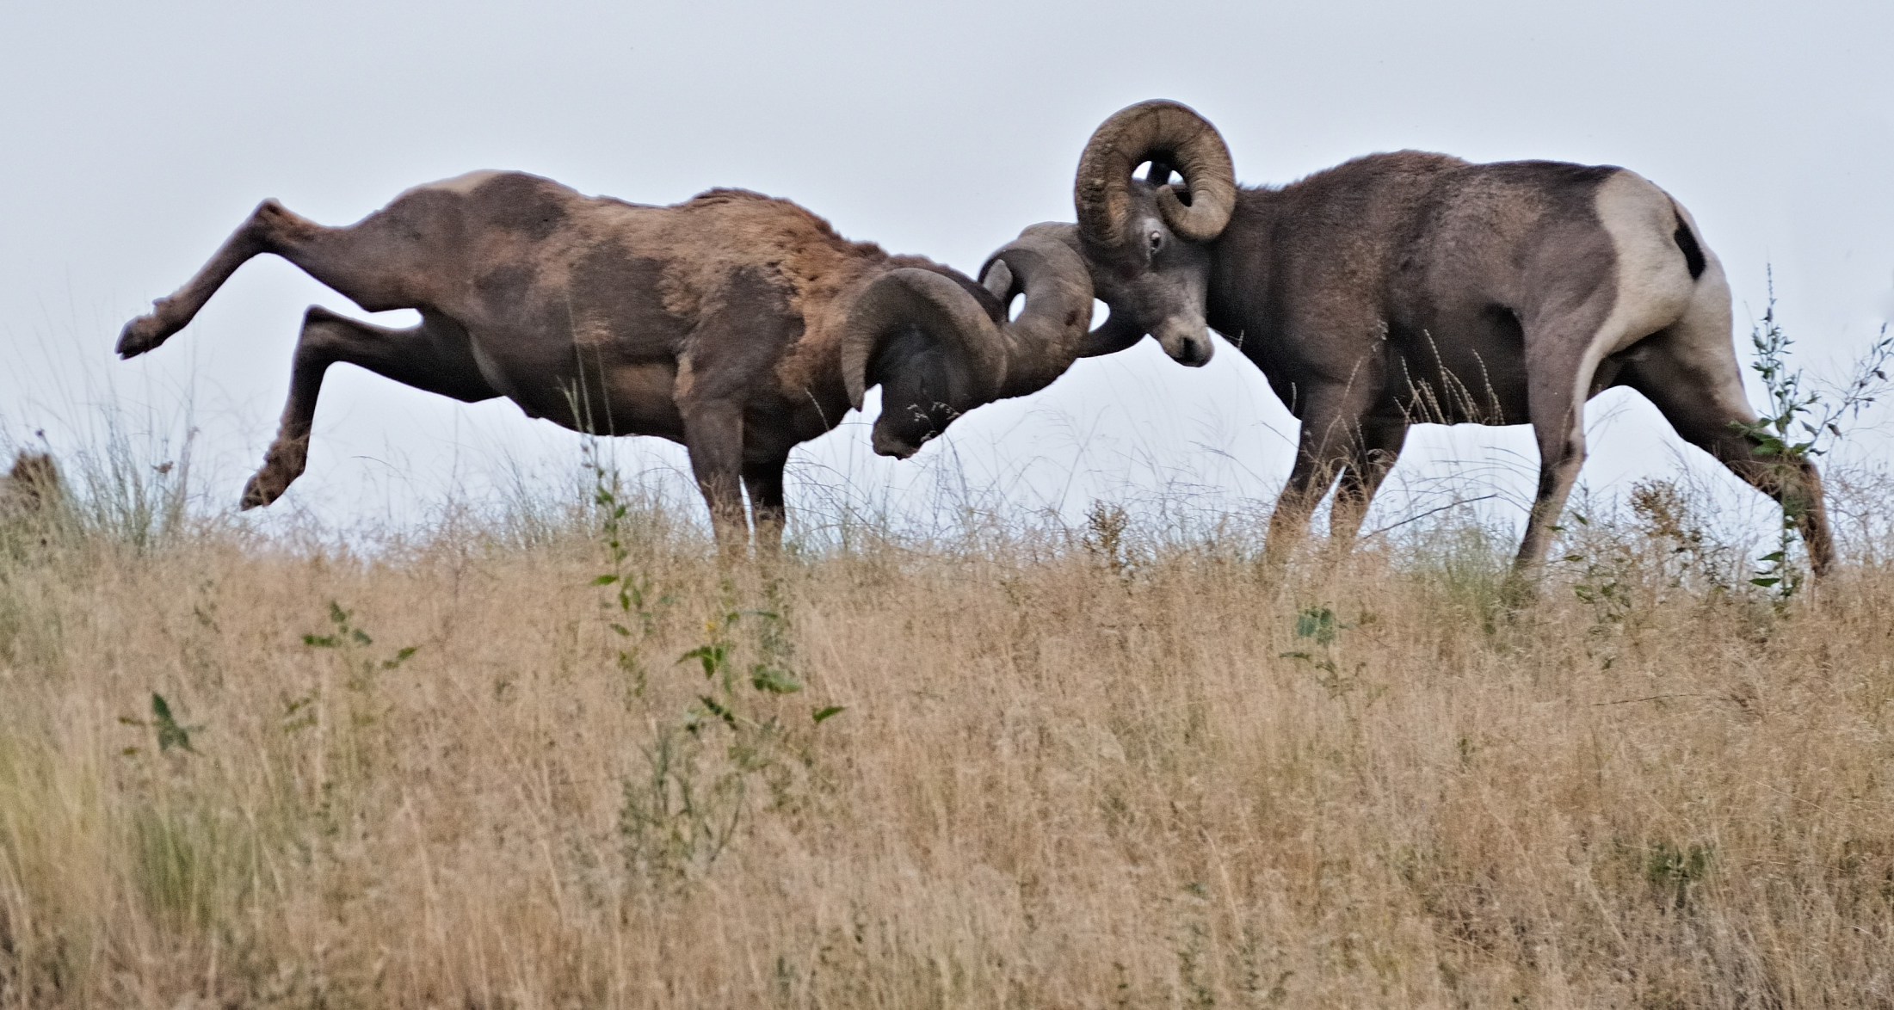
More About Bighorn Sheep
Mature rams spend most of the year in bachelor groups
The only time rams and ewes get together is during rut (mating season)
During rut, rams engage in fierce competition...the winner gets to mate with the females
Mating competition involves two rams running toward one another, at speeds up to 40 mph, and clashing their horns, which produces a sound that can be heard a mile away!

Slide 18
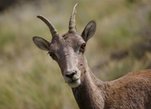
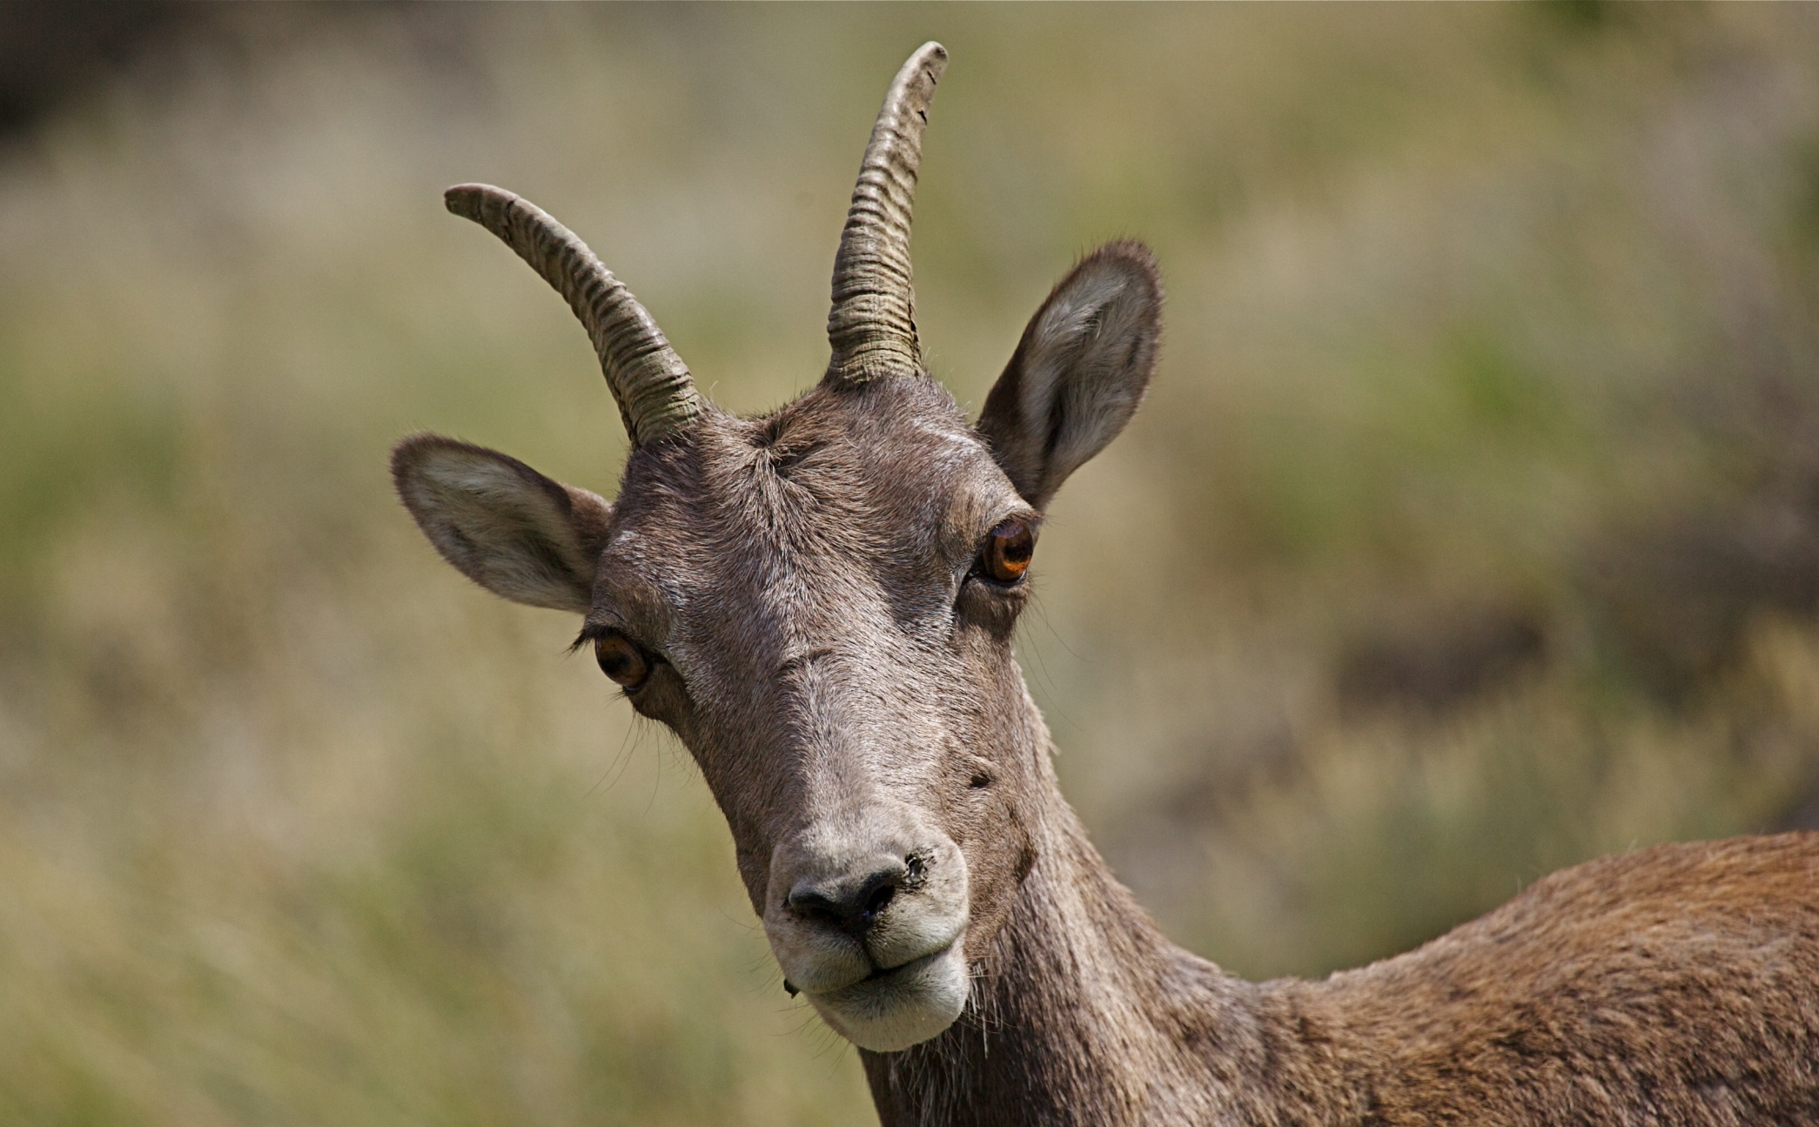
More About Bighorn Sheep
Female bighorn sheep, called EWES, have horns too
But they are short
with only a slight curve
The life span of wild ewes is typically between 10-14 years
Ewes live in social groups, and are joined by males only during the rut

Slide 19
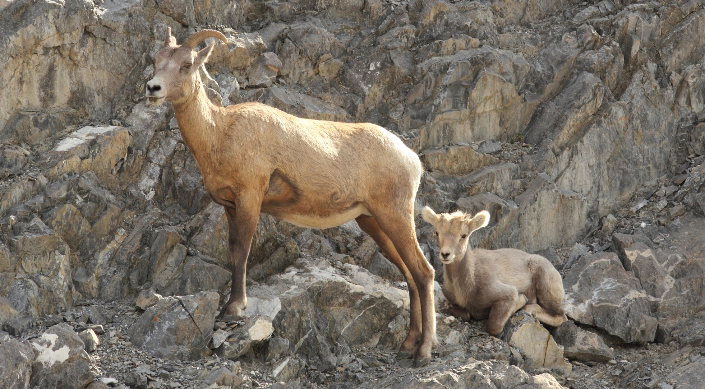
More About Bighorn Sheep
Pregnant ewes of the Rocky Mountains tend to go to higher elevations in spring to give birth in areas safer from predation
Bighorn ewes have a 6 month gestation period
Rut typically occurs in November so lambs are usually born during……?
May

Slide 20
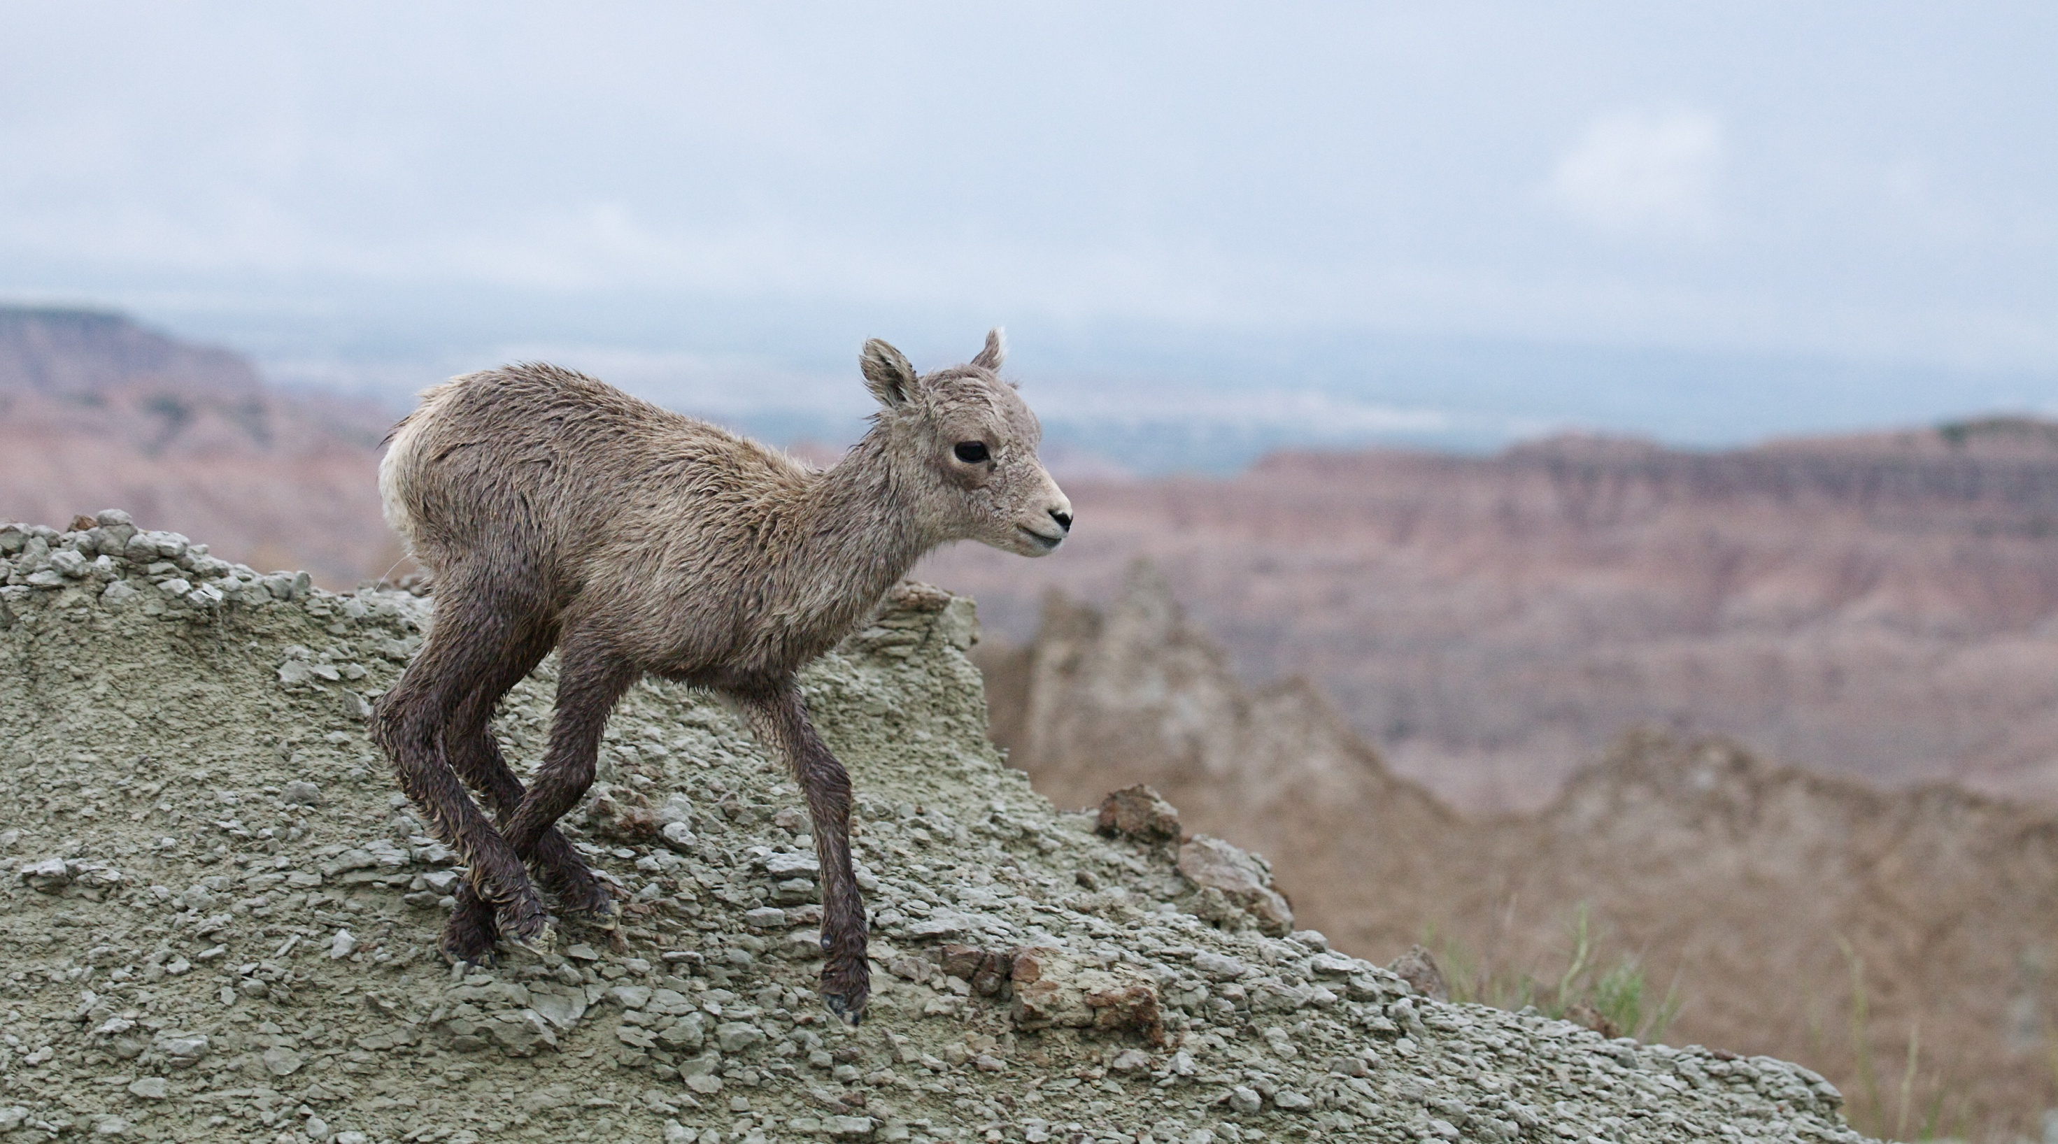
More About Bighorn Sheep
Ewes typically give birth to one lamb in spring
This is a LOW RATE OF REPRODUCTION, which makes bighorn sheep susceptible to population declines and die-offs
TIP: Remember this fact….it will be important when you have your class discussion later….

Slide 21
More About Bighorn Sheep
Ewes typically give birth to one lamb in spring
This is a LOW RATE OF REPRODUCTION, which makes bighorn sheep susceptible to population declines and die-offs
Newborn lambs weigh 8-10 pounds
Lambs can walk within hours after birth
At 1 week old, lambs and their moms join others in the herd
Mothers nurse lambs for 4-6 months

Slide 22
More About Bighorn Sheep
Let’s talk a bit about HABITAT
Habitat is the place where an animal lives
Habitat provides all the resources
an animal needs to survive and reproduce
What is HABITAT?
What RESOURCES do wild bighorn sheep need?
Food
Water
Escape cover to avoid predation
Let’s take a closer look at FOOD
resources that bighorns need to survive and reproduce

Slide 23
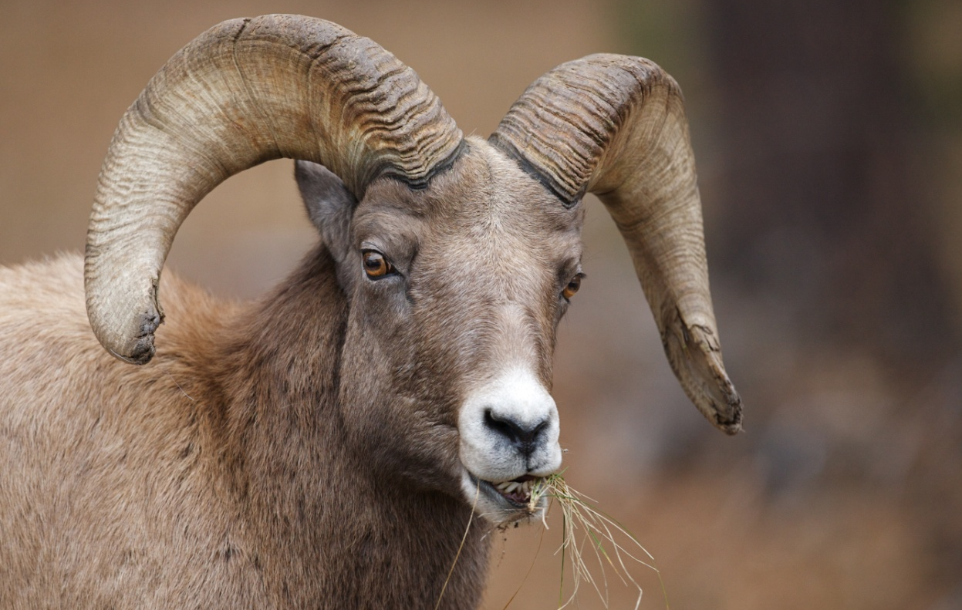
More About Bighorn Sheep
FOOD RESOURCES
Bighorn sheep are ruminants, with a 4-part stomach…..
…..they graze on grasses and sedges in summer….
…..they eat woody plants, twigs and shoots in winter
…..they seek minerals at natural salt licks
Having a 4-part stomach allows them to eat large amounts of food rapidly before retreating to cliffs or ledges where they re-chew and digest food, safe from predators

Slide 24
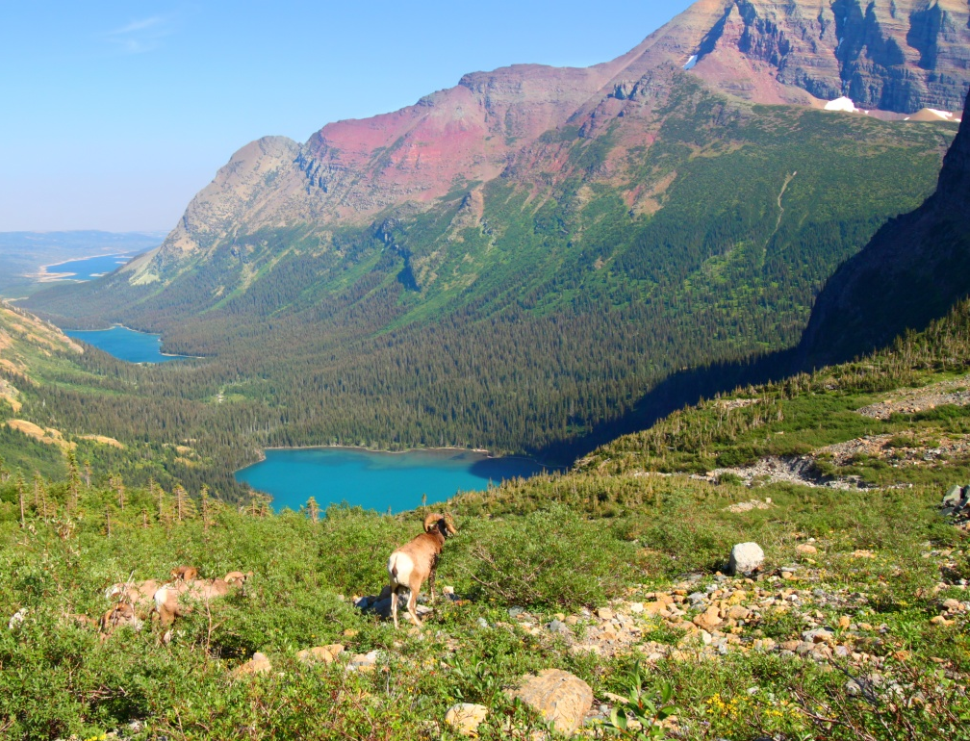
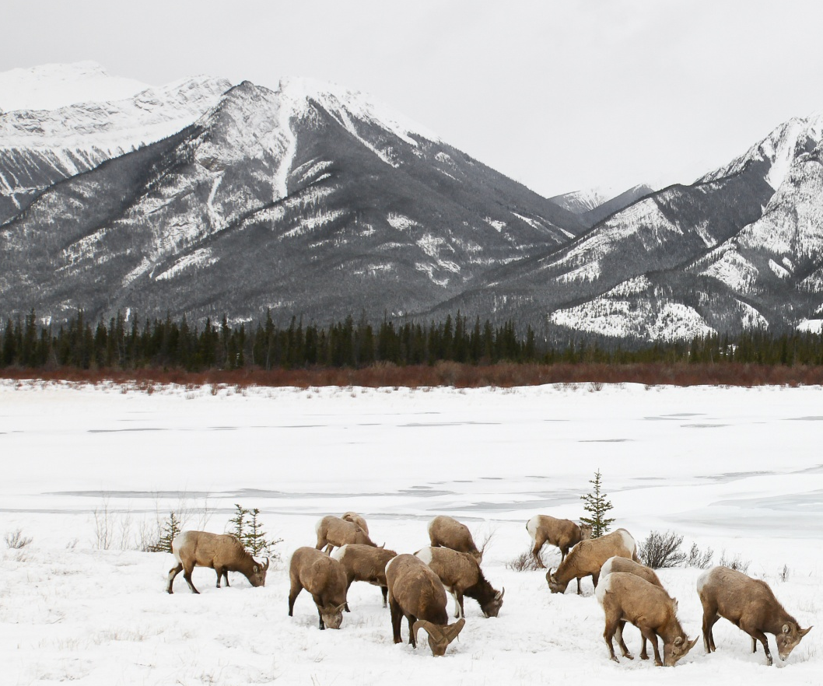
More About Bighorn Sheep
FOOD RESOURCES
Bighorn sheep populations usually MOVE SEASONALLY to find food
In summer, they generally use large upland areas, at about 6,000-8,500 feet elevation
In winter, they usually use sheltered valleys at about 2,500-5,000 feet elevation
Bighorn sheep can’t move through deep snow, so they like drier slopes with less than about 60 inches of snow/year

Slide 25
More About Bighorn Sheep
What RESOURCES do wild bighorn sheep need?
Food
Water
Escape cover to avoid predation
Now, let’s take a closer look at WATER

Slide 26
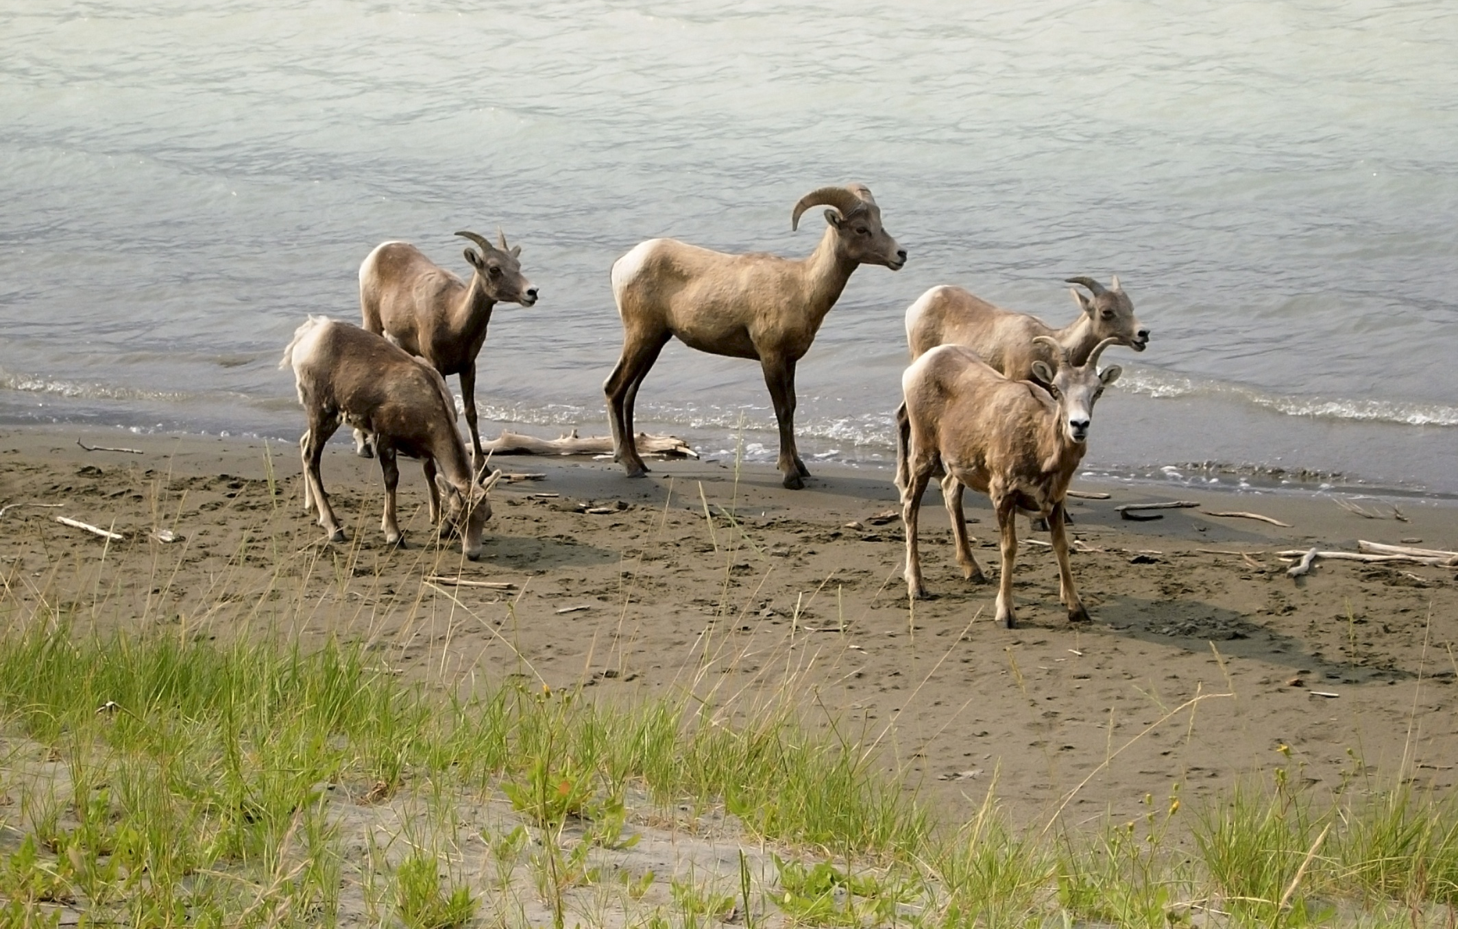
More About Bighorn Sheep
WATER RESOURCES
Just like all other animals, wild bighorn sheep need water
In addition to drinking water from places like streams, rivers, and lakes……..
As ruminants, bacteria in bighorn sheep’s
4-part stomach helps break down food. During this digestive process, bighorn sheep also absorb moisture and can go for long periods without water
….bighorn sheep get some water from their food

Slide 27
More About Bighorn Sheep
What RESOURCES do wild bighorn sheep need?
Food
Water
Escape cover to avoid predation
Now, let’s take a closer look at ESCAPE COVER

Slide 28
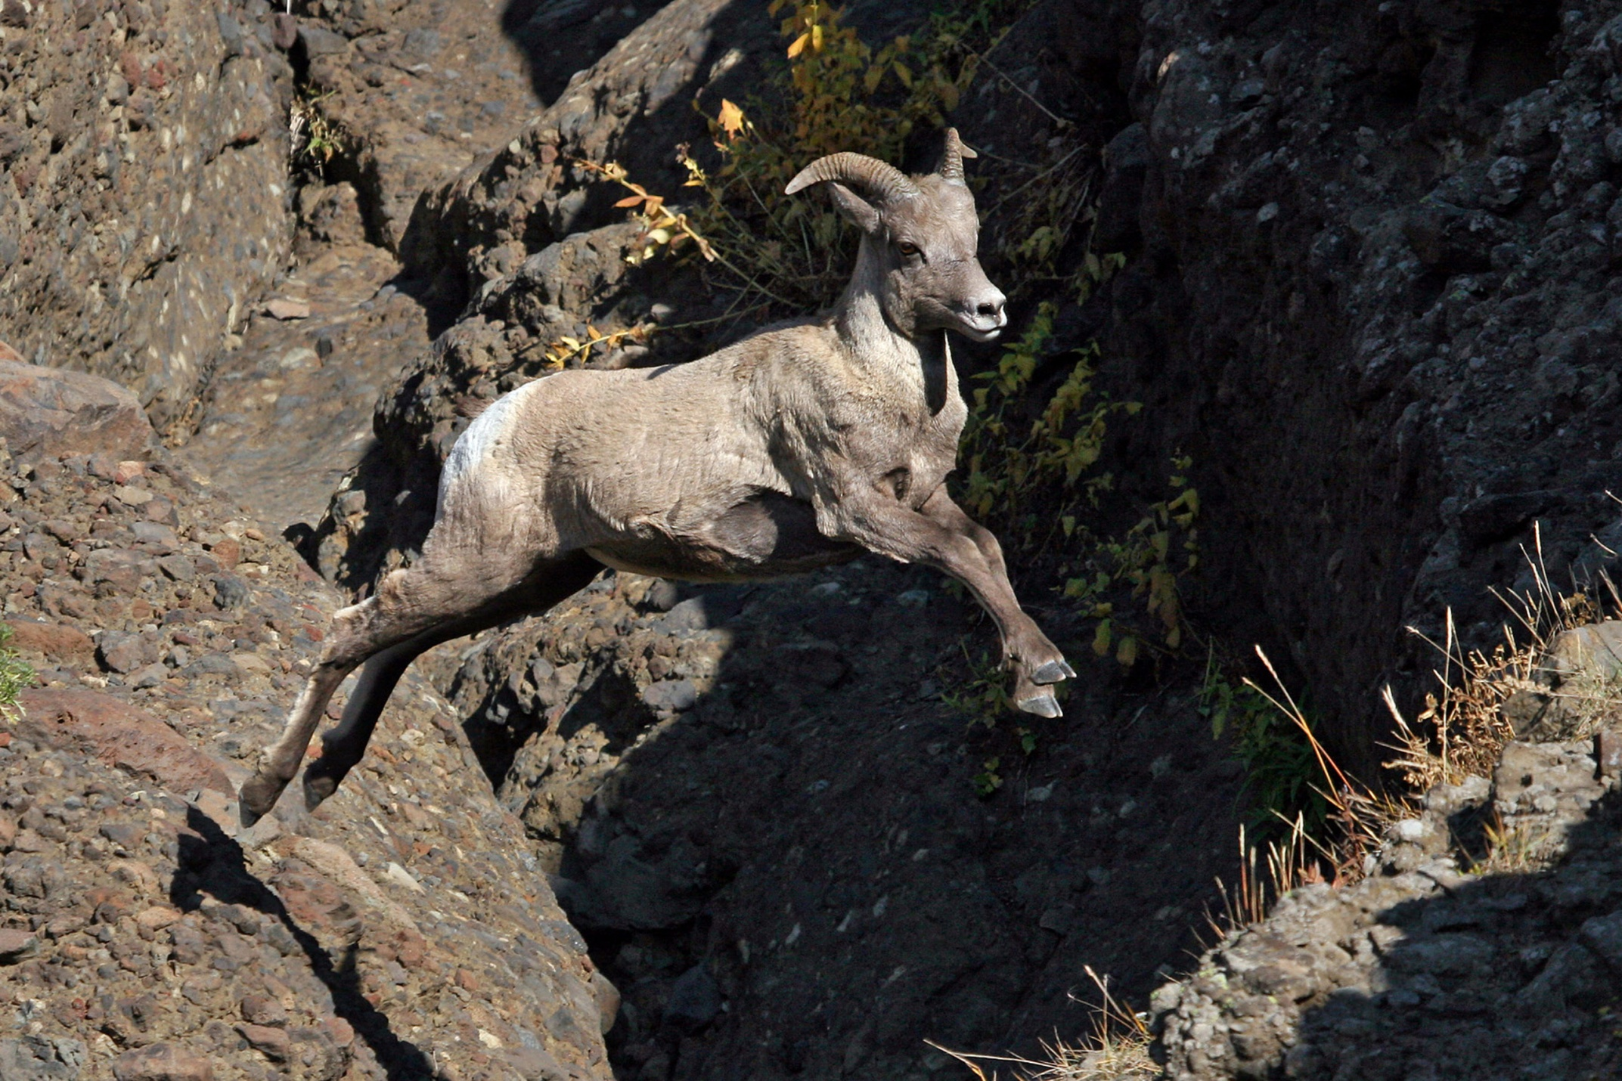
More About Bighorn Sheep
ESCAPE COVER RESOURCES
Bighorn sheep require steep and relatively treeless areas so they can spot predators and escape from them
This type of habitat occurs in two places:
Mountains above timberline
Deserts
Bighorn sheep groups protect themselves from predators by facing different directions….so they can keep watch on their surroundings
Bighorn sheep almost never wander further than 300 meters from their escape cover!

Slide 29
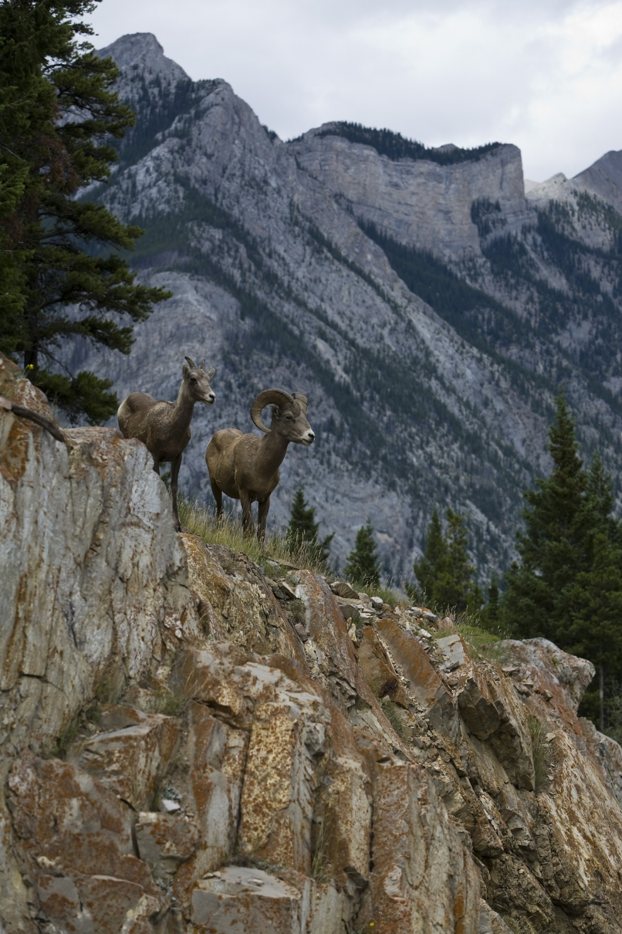
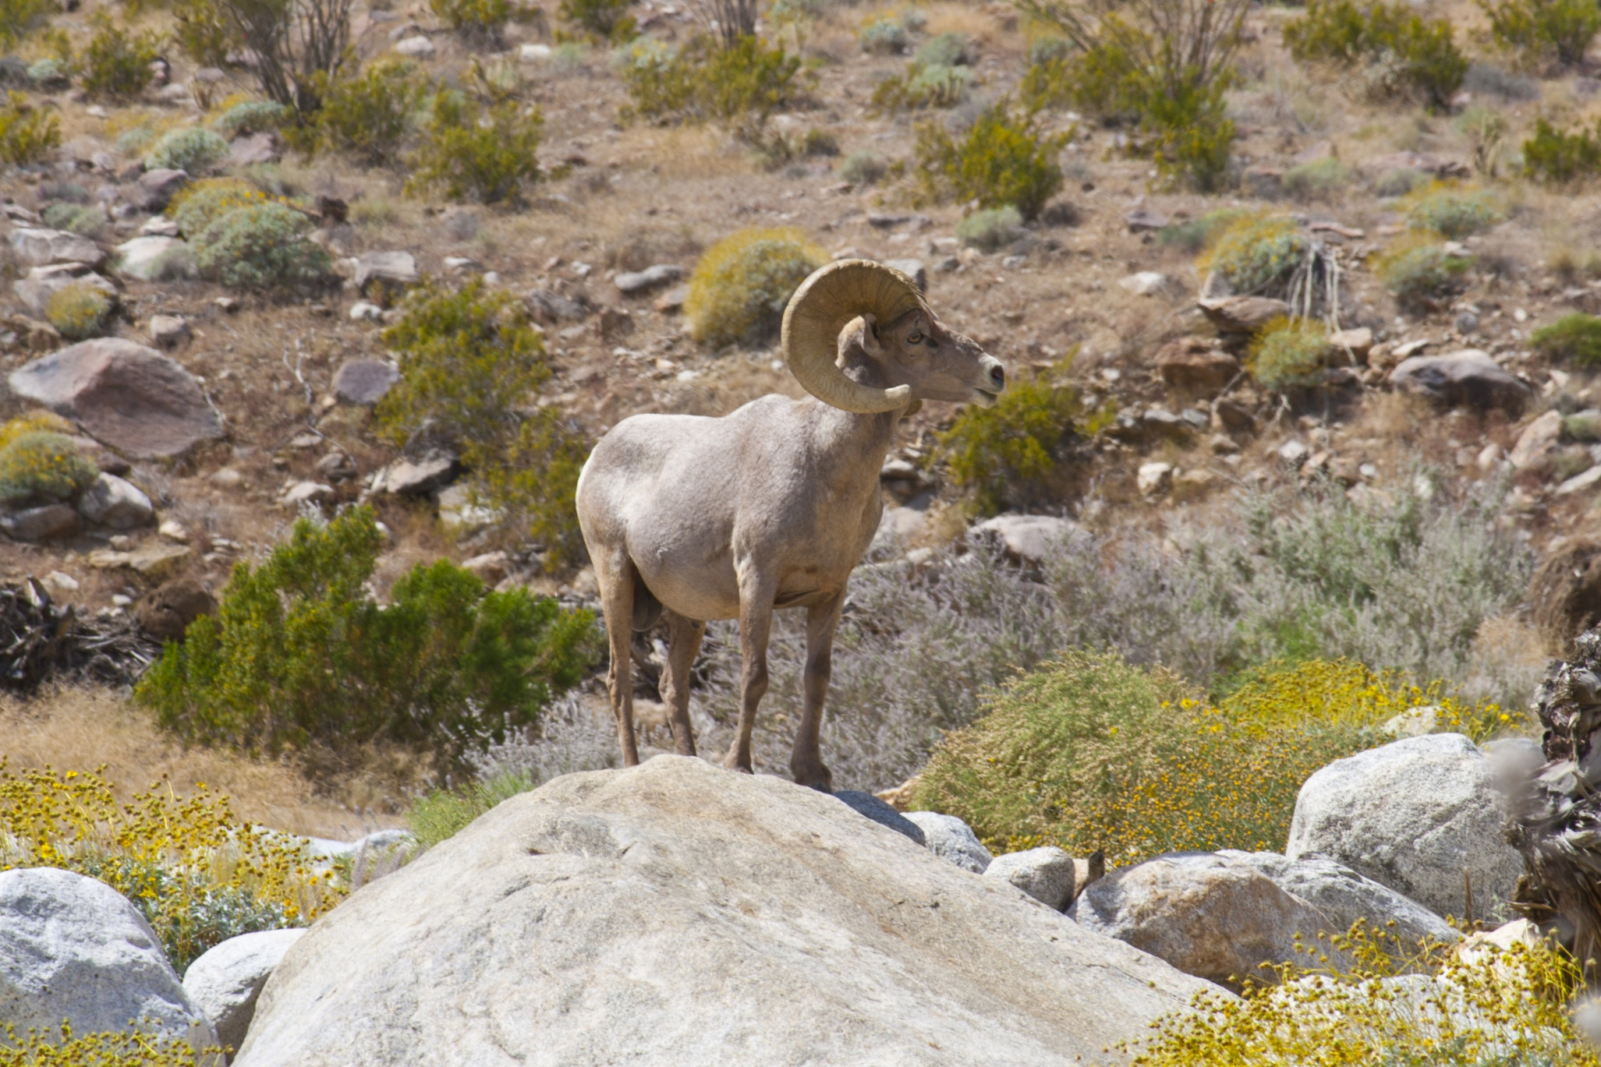
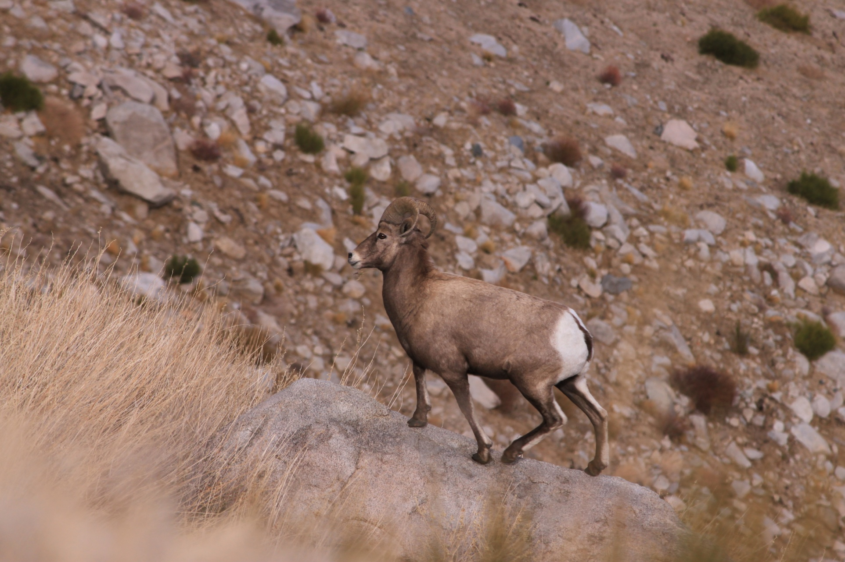
More About Bighorn Sheep
In the US, there are 3 subspecies of bighorn sheep
Rocky Mountain
Bighorn Sheep
Desert
Bighorn Sheep
Sierra Nevada
Bighorn Sheep

Slide 30
More About Bighorn Sheep
Sierra Nevada
Bighorn Sheep
They live only in
California’s high Sierra
Nevada Mountains
Some folks mistakenly
call them California
bighorn sheep
In 1999, the Sierra Nevada bighorn sheep was federally listed as endangered
Only about 400 Sierra Nevada bighorn sheep currently exist
Photo: CA DFG

Slide 31
More About Bighorn Sheep
Desert Bighorn Sheep
They live in arid canyon
lands and mountains of
the southwest in New
Mexico, Colorado, Nevada,
California, Utah and Texas
Water can be limiting, so
managers sometimes
provide water guzzlers
(artificial water sources)
for desert bighorn sheep
Cool fact: desert bighorn sheep have become well adapted to living in the desert heat and cold
Unlike most mammals, their body temperature can safely fluctuate several degrees!

Slide 32
More About Bighorn Sheep
Rocky Mountain
Bighorn Sheep
Of the 3 subspecies,
Rocky Mountain bighorns
are the most widely
distributed in the west
They live in the high peaks
of the inter-mountain
west, from Canada to
parts of Arizona
We will focus on Rocky Mountain bighorn sheep for our CASE STUDY ACTIVITY

Slide 33
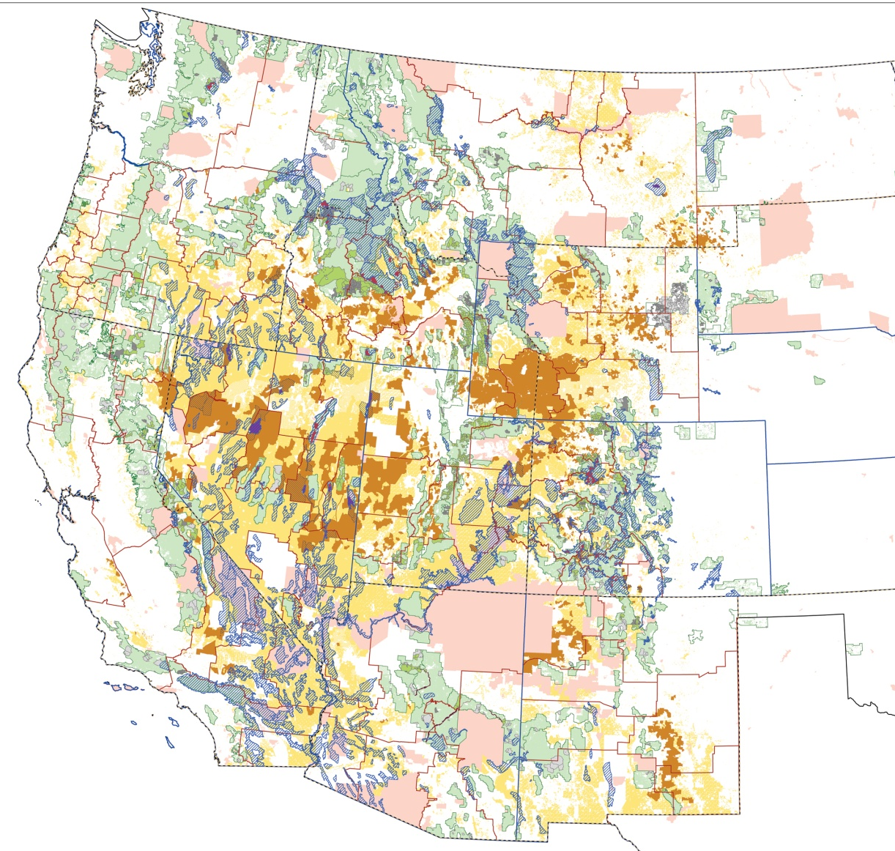
Case Study Activity with REAL DATA
For our case study activity, we will focus on Rocky Mountain bighorn sheep herds that occur in Montana
Washington
Montana
North Dakota
Oregon
Idaho
South Dakota
Wyoming
Nebraska
Nevada
Utah
Colorado
Rocky Mountain bighorn sheep live in the following states
Arizona
New Mexico
We will focus on Rocky Mountain bighorn sheep for our CASE STUDY ACTIVITY

Slide 34
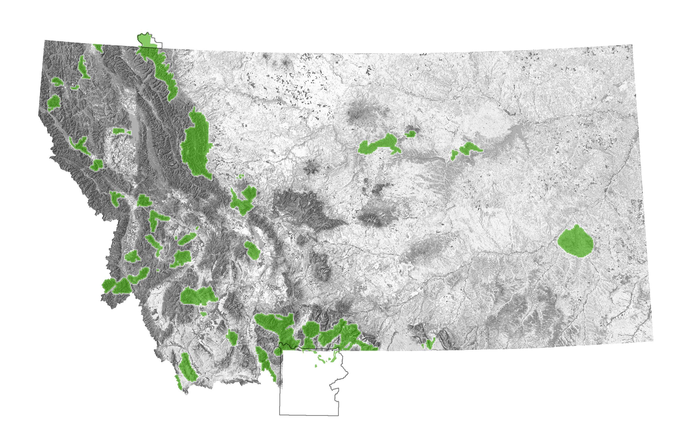
Case Study Activity with REAL DATA
Rocky Mountain Bighorn Sheep herds in Montana
In Montana, there are 45 herds of Rocky Mountain bighorn sheep
Herds are shown in GREEN on this map
For our case study activity, we will focus on these 6 herds

Slide 35
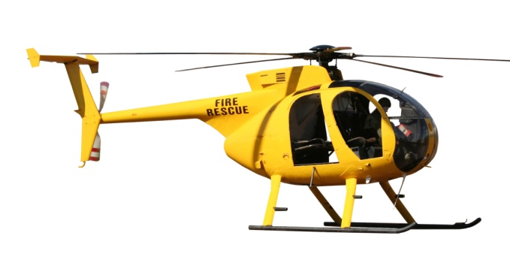
Case Study Activity with REAL DATA
Rocky Mountain Bighorn Sheep herds in Montana
For each of these 6 herds, wildlife scientists have been collecting DATA (information)
For our case study activity, we will focus on these 6 herds
For example, scientists use aerial surveys with helicopters and airplanes (and sometimes they go on foot) to estimate how many bighorn sheep are in each herd each year
You will be using these DATA to answer questions like:
Scientists also document mortality causes, and other factors that affect conservation efforts
Are bighorn sheep on the edge?
What factors affect the conservation of wild bighorn sheep?

Slide 36
Case Study Activity with REAL DATA
Let’s get started!
Step 1: Your teacher will divide the class into 6 groups
Step 2: Each group will be assigned one of the 6 case studies on
wild bighorn sheep, including real data
Step 3: Each group will be given STUDENT PAGES to work through
Step 4: Each group will present their group findings to the class
Step 5: Using results from all group presentations, the class will
work together to determine whether or not bighorn sheep are on the edge and create a combined list of
factors affecting bighorn sheep conservation

Slide 37
Case Study Activity with REAL DATA
When groups have finished presenting results to classmates and after you worked as a class to create the combined list of factors affecting bighorn sheep conservation, come back to this slide show to see if your graphs and answers match those presented by the bighorn sheep scientists

Slide 38
Case Study Activity with REAL DATA
End of Slide Show
Part I

